Slide 1
Online Edu. Employment
Prototype 15/9/ 2015

Slide 2
Prototype
Agenda
1. Process of the first sprint
2.Pototype display
3. Conclusion

Slide 3
1.Process of the first sprint
Sprint Planning
.NET and MySql
Estimate time
Sprint Backlog

Slide 4
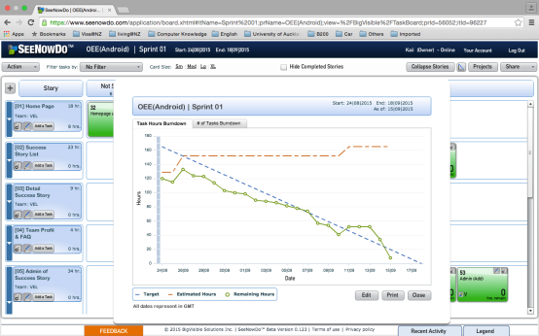
1.Process of the first sprint
Daily Scrum

Slide 5
1.Process of the first sprint
Daily Scrum
Every two days
Help each other
Solve problems

Slide 6
1.Process of the first sprint
Sprint Review
Presented our achievement
Get his feedback

Slide 7
2.Pototype display

Slide 8
3. Conclusion

